Slide 1
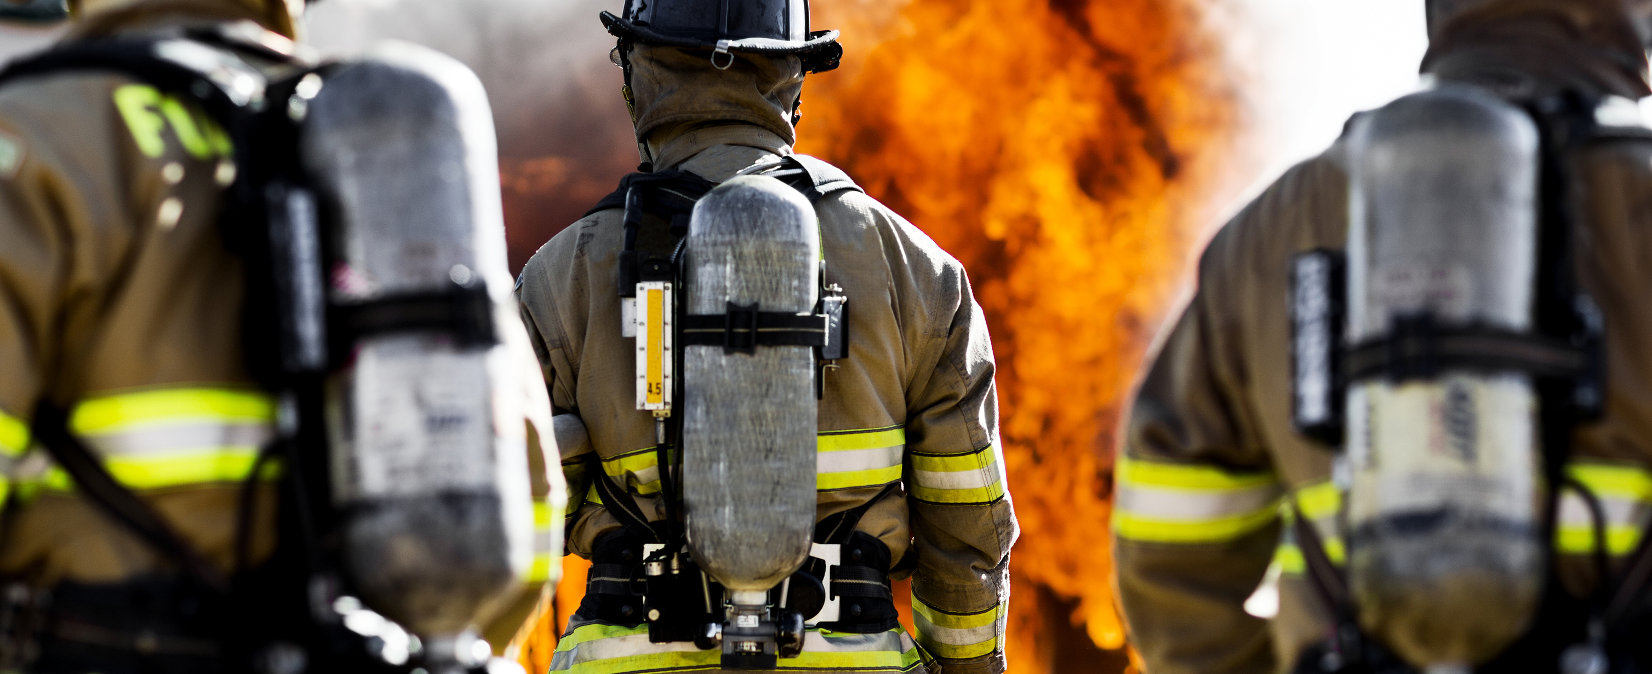
TROOPS TO
FIREFIGHTERS
Jobs For Our Troops!
www.troopstofirefighters.org
August 14, 2024

Slide 2
Our Mission
Connect you to a fire certification program and provide you mentoring and job placement support

Slide 3
Who Is Eligible?
Transitioning soldiers or veterans, including:
Army
Marine Corps
Navy
Air Force
Coast Guard
Space Force
National Guard or Reservist

Slide 4
Fire Certification Program
WHERE:
Sandhills Community College Pinehurst, NC
WHEN:
Two cohorts - 2nd Monday in January and July
TERM:
5 ½ months duration

Slide 5
Curriculum
Firefighter I & II
EMT
Hazmat Awareness
Technical Rescue
Cost - about $2,000*
*If you volunteer with a local fire department your program expenses will reduce to under $400

Slide 6
Where are they now?
KANSAS
CALIFORNIA
GEORGIA

Slide 7
Can I Use My GI Bill?
No

Slide 8
May I skip EMT requirement, if I already have EMT certification?
Yes*
*You won’t graduate early

Slide 9
Contact Us
Chief Andrew James
Program Director
Columbia, SC
803-727-5466
andrew.james@scmd.sc.gov
Wellington Davies
Executive Director
Phoenix, AZ
908-310-9597
wellington@troopstofirefighters.org

